Slide 1
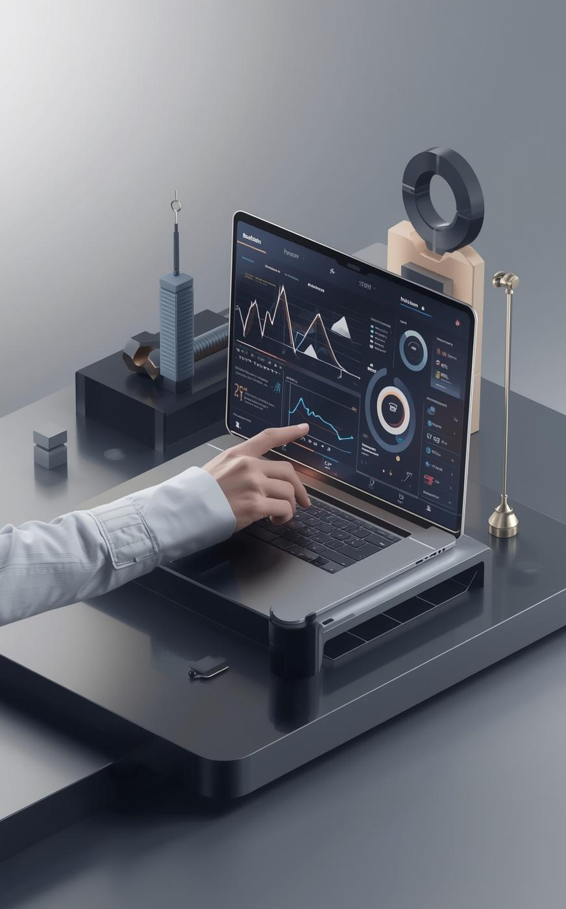
INTRODUCING BUDGETWISE
AI Based Expense Forecasting Tool
Presente By - Team 1
Total No. of Team Members: 5
Mentor: Sangeetha Mahalingum

Slide 2
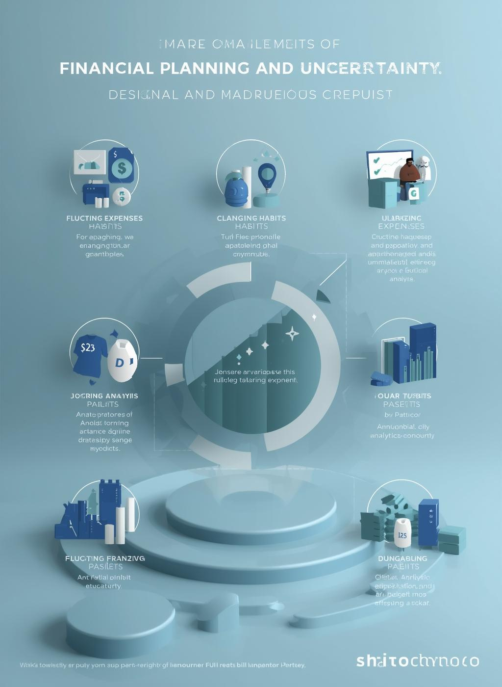
Understanding the Uncertainty in Financial Planning
The Problems in Managing Personal and Business Expenses
Unpredictable Expenses 🛠️
Life is full of surprises. Sudden costs from medical emergencies, urgent home repairs, or unexpected job loss can arise without warning, making it nearly impossible to stick to a rigid, pre-planned budget.
Income Volatility 🌊
Not everyone earns a stable, fixed salary. For freelancers, gig workers, and those in sales, income can fluctuate dramatically from one month to the next, making it difficult to forecast cash flow and plan future spending accurately.
Limitations of Traditional Budgeting Methods 😩
Traditional budgeting methods often rely on static assumptions, lack real-time data integration, and fail to adapt to changing financial behaviors, leading to inaccurate and inflexible expense forecasts.

Slide 3
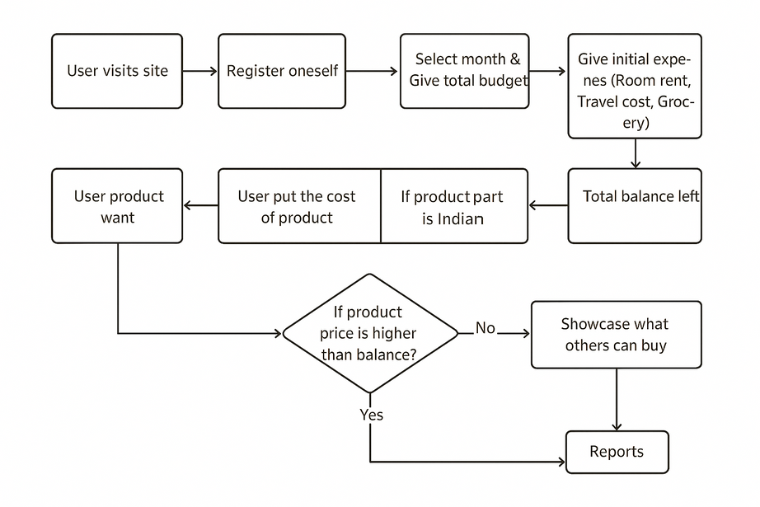
Our Innovative Approach to Expense Forecasting
METHODOLOGY
Meet Budgetwise: Your Financial Crystal Ball
Our innovative approach redefines expense forecasting by turning it into an interactive decision-making tool. Instead of just tracking past expenses, our system empowers users to make confident purchasing decisions in real-time. By providing a monthly budget and fixed costs, the user gets an instant calculation of their true discretionary spending power. This allows them to perform on-the-spot 'affordability checks' for any desired product, receiving immediate feedback and smart, AI-driven suggestions if an item is beyond their current reach. Also adding chatbot that can interact with user.

Slide 4
Key Features of BudgetWise
Real-time Forecasting
BudgetWise offers real-time forecasting capabilities, allowing users to track their expenses as they occur. This enables immediate insights into spending patterns and helps users to adjust their budgets dynamically, ensuring they stay on top of their financial goals.
Exploring the unique functionalities that make BudgetWise an exceptional forecasting tool
Customizable Budgets
With customizable budgets, users can tailor their financial plans according to personal preferences and unique spending habits. This flexibility empowers individuals to create budgets that reflect their lifestyle, providing a personalized approach to financial management.
AI-Driven Suggestions
BudgetWise utilizes AI-driven alerts to notify users of significant spending changes or potential overspending. These proactive notifications help users make informed financial decisions, fostering better habits and avoiding unnecessary financial strain.
Visualizations with Graphs & Plots
Charts and graphs that showcase users about their expenses and reports.
These visual insights help users understand their spending patterns and identify areas where they can save more.
AI Chatbots
AI Chatbots assist users by providing personalized budgeting tips and answering financial queries instantly.
They guide users throughout the process — from registration to expense tracking — with interactive suggestions.

Slide 5
The Technology Stack Behind BudgetWise Forecasting Tool
Frontend
Model Used
Built using HTML, CSS, and JavaScript to create an intuitive and responsive user interface for easy navigation and interaction.
Random Forest algorithm provides reliable budget predictions by learning patterns from historical data.
Automation & Integration
Backend
n8n is used for automating workflows, integrating APIs, and streamlining data processes.
Developed with Python and Flask, handling server-side logic, API endpoints, and seamless communication with the frontend.
Chatbot
Database
Integrated to assist users with queries and guide them through budgeting tasks efficiently.
MySQL is used for storing and managing structured data securely, including user inputs and prediction results.
Version Control
AI Frameworks
GitHub is used for source code management, collaboration, and version tracking of the project.
PyTorch and TensorFlow power the machine learning models, enabling accurate forecasting and data analysis.

Slide 6
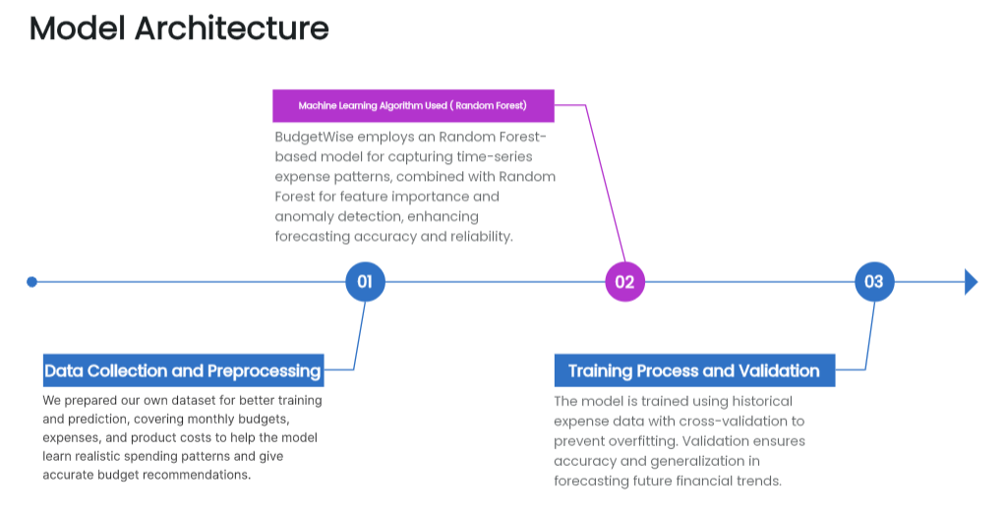
AI/ML Model Architecture of BudgetWise
Understanding the core workings behind our expense forecasting tool
The BudgetWise AI/ML model is built using the Random Forest algorithm to deliver accurate expense predictions. It processes key financial features during training to ensure reliable and consistent results. By utilizing our prepared dataset containing monthly budgets, expenses, and product costs, the model learns realistic spending patterns, enhancing its adaptability and providing personalized financial insights for each user.

Slide 7

Performance Metrics of BudgetWise: Results that Matter
As a result, the performance of BudgetWise delivers an engaging and user-friendly experience with an intuitive landing page and interactive dashboard. The platform ensures secure and seamless user authentication for smooth access and personalized interaction. Our Random Forest–based model provides accurate predictions on custom datasets, helping users manage budgets effectively. Additionally, the integrated AI chatbot enhances user communication with fast, reliable, and context-aware responses, ensuring a smooth and responsive experience throughout.

Slide 8
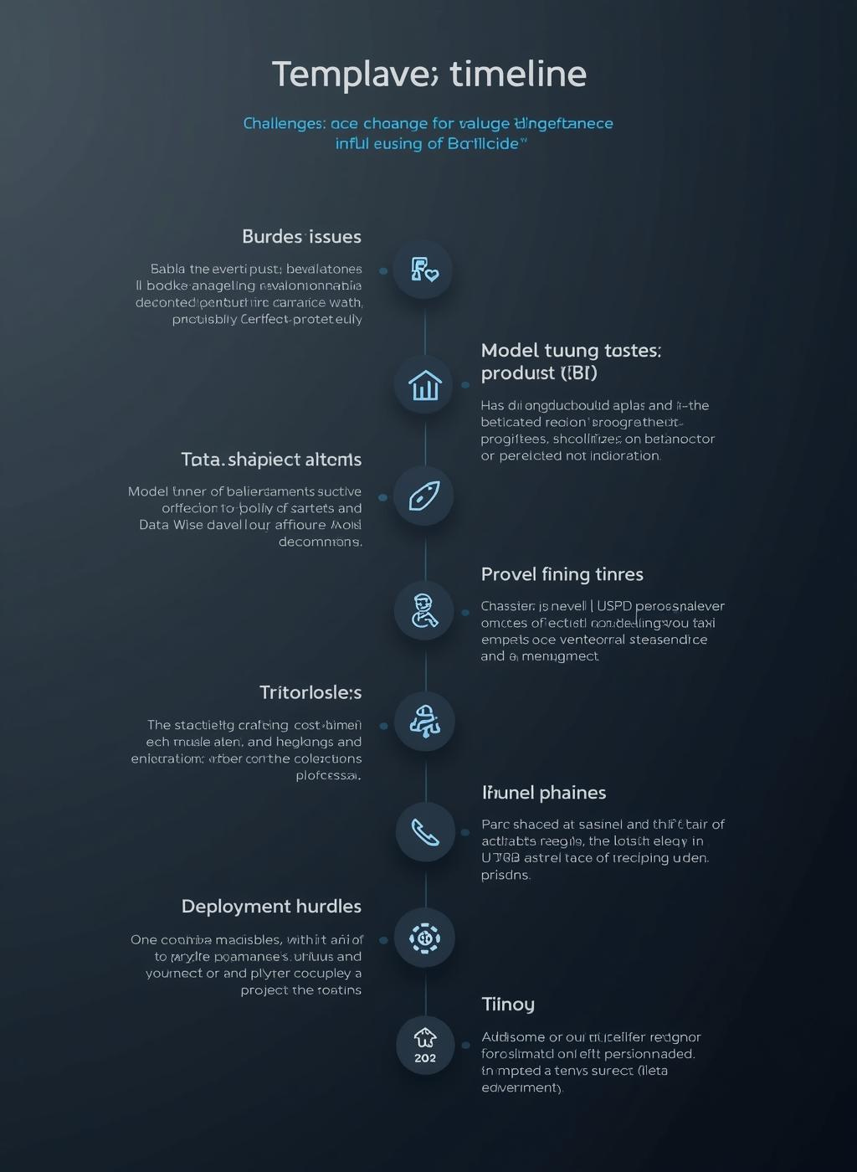
Overcoming Challenges in Developing BudgetWise
🧩 Challenges
Difficulty finding a suitable dataset for accurate model training.
Confusion in selecting the best algorithm for expense prediction.
Limited backend development knowledge among team members.
Integration issues between frontend, backend, and ML model.
Communication gaps and task coordination challenges within the team.
💡 Overcomes / Learnings
Created our own custom dataset to improve model accuracy and relevance.
Chose Random Forest after testing and performance comparison with other models.
Gained hands-on backend knowledge through research and mentor guidance.
Solved integration issues by systematic testing and debugging of modules.
Improved teamwork with regular meetings, progress discussions, and shared documentation.

Slide 9
Future Enhancements for BudgetWise
Integration with Banking Apps
Securely link bank accounts to automate transaction imports, eliminating manual entry and keeping finances effortlessly updated.
Real-time Expense Tracking & Categorization
Instantly track and categorize purchases as they happen, providing an immediate and live view of your budget's health.
Exploring potential features and improvements to elevate user experience and functionality
Advanced Analytics Features
Unlock deeper insights with "what-if" scenarios, spending pattern analysis, and personalized tips to optimize your budget.
Multi-currency & Localization
Add support for multiple currencies with live conversion rates, making the app perfect for travelers and international users.
Intelligent Mobile Notifications
Receive proactive smart alerts for unusual spending, upcoming bill reminders, and progress summaries to stay ahead of your finances.

Slide 10
CONCLUSION & ACKNOWLEDGEMENTS
Summary of Project Impact
Thanking Team and Mentor
BudgetWise enhances financial planning by accurately forecasting expenses, empowering users to manage budgets effectively. Future improvements include AI model refinement and expanded integration for broader usability and impact.
We sincerely thank our dedicated team for their hard work and creativity, and our mentor for invaluable guidance and support throughout the development of BudgetWise, enabling its success.
– Team 1 of Infosys Springboard Internship

Slide 11
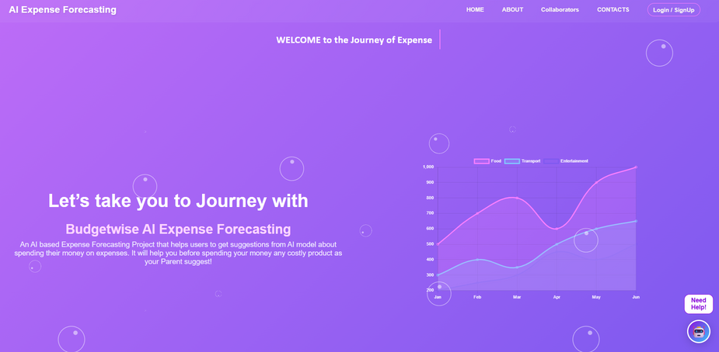
Thank You!
Presented By- Team 1

